Slide 1

CMP1101:
MOS TRANSISTORS

Slide 2
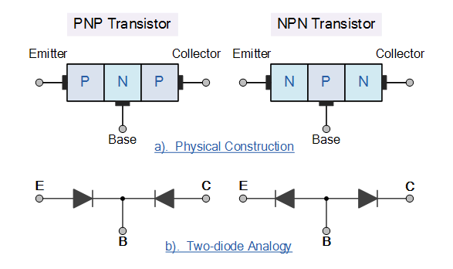
Review: BJT TYPES

Slide 3
Review: BJTs contd.
BJTs are bipolar three layer device constructed from two diode junctions joined together
One p-n junction in the forward bias
Second p-n junction in the reverse bias
Two main types of BJTs exist
NPN transistor
PNP transistor
BJTs are current regulating devices that control the amount of current flowing through them in proportion to the amount of biasing voltage.
It thus acts like a current-controlled switch.

Slide 4
BJT OPERATION
The base-emitter junction is always forward biased while the base-collector junction is always reverse biased.
For either the NPN or PNP BJTs, the standard current equation is given by
I_{E} = I_{B} + I_{C}
The NPN transistor requires the base to be more positive than the emitter while the reverse is true for the PNP transistor.
Thus the biasing and polarity of the power supplies for each type are different.
Otherwise, the principle of operation of a PNP and an NPN is exactly the same.
Since the BJT is a 3 terminal device, there’s 3 different ways (configurations) of connecting it within an electronic with one terminal being common to both the input and the output: Common-base, common-emitter and common collector configurations.

Slide 5
FIELD EFFECT TRANSISTORS (FETs)
FETs (unipolar transistors) are voltage operated devices with high input resistance such that very little or no current flows into the input terminal.
This makes them ideal for use as electronic switches.
They either use electrons or holes for conduction (unipolar).
They are operated using an electric field to control the behavior of the device.
FETs are divided into 2 types:
Junction gate devices (JFETs) and the
Insulated-gate devices (IGFETs) or more commonly referred to as Metal Oxide Semiconductor FET (MOSFET)
MOSFETs are further subdivided into
Enhancement type (always OFF) and depletion type (always ON)
Both forms are available in N-channel (NMOS) and P-channel (PMOS).

Slide 6
FETs contd.
FETs have a much higher current gain as compared to BJTs
This makes them ideal for use as electronic switches.
Just like BJTs, FETs have three terminals (technically 4)
The gate, source and the drain.
The fourth terminal is the body (substrate) which is connected to the source.
The most common FET connection is the common-source configuration but common-gate and common-drain configurations are also in use.
FETs can be used to replace BJTs in electron circuits with a few tradeoffs as illustrated in the following chart.

Slide 7
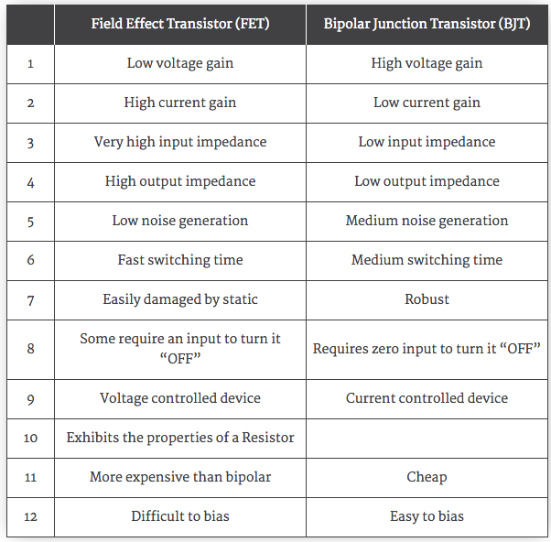
FETs contd.

Slide 8
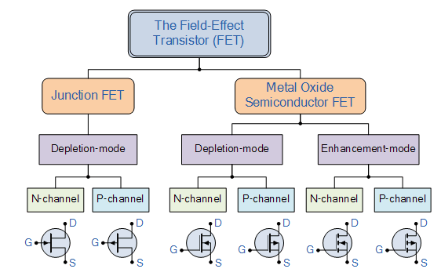
FETs contd.

Slide 9
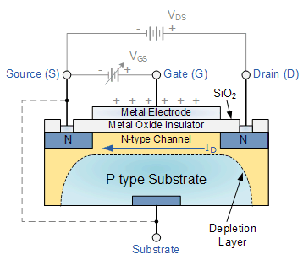
MOSFETs
MOSFETs are the most common type of insulated gate .
This makes them ideal for use as electronic switches.
They are voltage controlled devices with a much higher input impedance than the JFETs.
The boy
The gate is electrically insulated from the main semiconductor P-channel or N-channel by a very thin layer of insulating material usually silicon dioxide (glass).
The boy

Slide 10
MOSFETs contd.
The MOSFET is the most common transistor in digital circuits.
Up to millions of them may be included in a memory chip or microprocessor.
The semiconductor of choice in MOSFETs is silicon but
Recently, some manufacturers started using silicon and germanium (SiGe) in MOSFET channels.
Unfortunately, some very good semiconductors such as gallium arsenide don’t form good semiconductor-to-insulator interfaces and as such are not suitable for MOSFETs.

Slide 11
MOSFET Construction
The traditional MOS structure is obtained by growing a layer of silicon dioxide (SiO₂) on top of a silicon substrate.
A layer of metal or polycrystalline silicon is then deposited on top.
Since silicon dioxide is a dielectric material, the MOSFET structure at the gate area is equivalent to a planar capacitor.
The semiconductor material replaces one of the electrodes.
A MOS capacitance is created between the body electrode and the gate electrode.
The gate electrode is insulated from all other device regions by the gate dielectric layer.

Slide 12
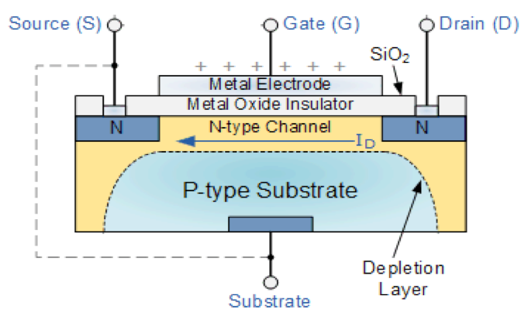
MOSFET Construction contd.
The gate electrode is electrically isolated from the main semiconductor.
MOSFETs also contain a pair of highly doped n-type or p-type regions right under the drain and source electrodes to give:
N-channel (NMOS) and
P-channel (PMOS) respectively.
The isolation of the controlling gate makes the input resistance of the MOSFET almost infinite (MΩ).
All MOSFETs use an electric field produced by a gate voltage to alter the flow of charge carriers; electrons for N-type and holes for P-type

Slide 13
MOSFET Operation
The operation of MOSFETs is broadly categorized under
Enhancement mode MOSFETs (eMOSFET)
Depletion mode MOSFETs
These two categories of MOSFETs operate in reverse of each other.
The eMOSFET is always OFF and requires a voltage to get to the ON state while,
The depletion mode MOSFET is always ON and requires a voltage to get to the OFF state.
The eMOSFET is more common than the depletion mode MOSFET

Slide 14
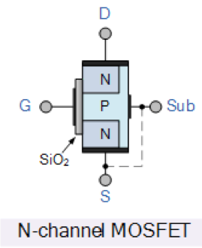
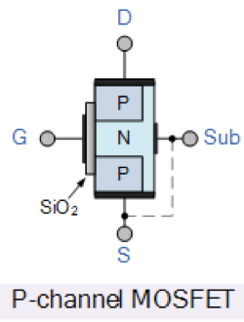
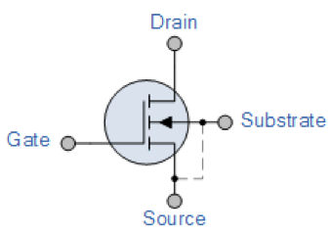
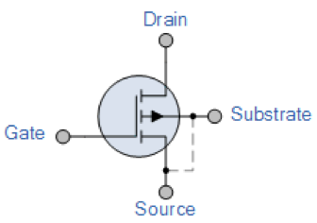
Enhancement Mode MOSFETs (eMOSFET)
eMOSFETs can be N-channel or P-channel, are always OFF and require a voltage to get ON.
Thus, the conducting channel is lightly doped or even undoped making it non-conductive.
The circuit symbol for the eMOSFET uses a broken line to signify a normally open (non-conductive) channel.

Slide 15
N-channel eMOSFETs
A drain current only flows when a gate voltage, V_{GS} (greater than the threshold voltage, V_{TH}) is applied to the gate terminal.
The application of a positive gate voltage:
Attracts more electrons towards the oxide layer around the gate.
This increases (enhances) the thickness of the channel allowing more current to flow.
Increasing the positive voltage causes the channel resistance to decrease further resulting in an increase in the drain current, I_{D}.
A zero voltage or –V_{GS} turns the MOSFET OFF.

Slide 16
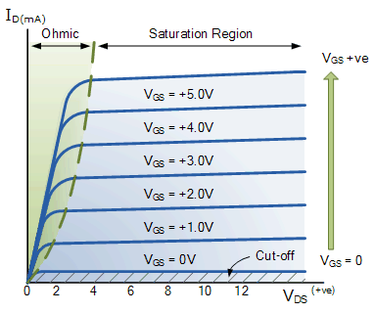
N-channel eMOSFETs contd.
The i-v characteristic of the n-channel eMOSFET thus shows an upward variation in the drain current, I_{D} for increases in the gate voltage V_{GS}.
The cut off region:
V_{GS} less than V_{GS}
The gate-source voltage is less than the threshold voltage and so the MOSFET is in the full OFF state (open circuit).
Ohmic (Linear) Region:
V_{GS} greater than V_{GS;} V_{DS} less than V_{GS}
The transistor is in it’s constant resistance region and behaves as a voltage controlled resistor whose resistive value is determined by the gate voltage, V_{GS}.

Slide 17
N-channel eMOSFETs contd.
Saturation region:
V_{GS} greater than V_{TH}
The transistor is in its constant current region and is switched fully ON. The current reaches its maximum as the transistor acts as a closed circuit.
eMOSFETs are very popular electronics switches due to their low ON resistance and extremely high OFF resistance.
eMOSFETs are used in integrated circuits to produce CMOS type logic gates in the form of PMOS (P-channel) and NMOS (N-channel) gates.

Slide 18
P-channel eMOSFETs
The operation of P-channel eMOSFETs is in reverse to it’s N-channel counterparts.
When V_{GS} is equal to 0V or even positive, the device is OFF and the channel is open.
The application of a negative gate voltage to the P-channel enhances the channel conductivity turning it ON.

